Slide 1
Prof. L Benedict Michael Raj, M. Sc, M. Phil, Ph.D.
Head and Associate Professor,
Department of Mathematics,
St Joseph’s College Trichy-2.

Slide 2
Application of Mathematics
IDHAYA COLLEGE FOR WOMEN
SARUGANI, SIVAGANGAI
Date:- 13-09-2017

Slide 3
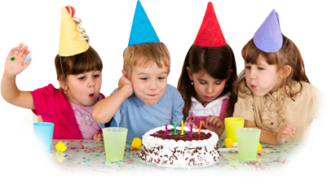
BIRTHDAY PARTY
YUMMY CAKE!!!!!!

Slide 4
BUT JUST ONE CAKE!!!!!!
SO………. WE SHARE!!!!!

Slide 5
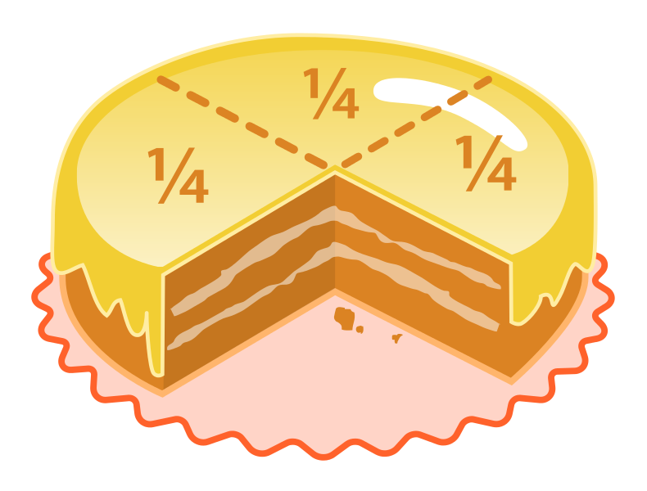
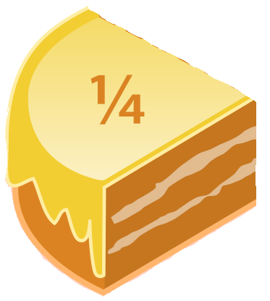
Each child gets ¼ of the Cake.
Here, just a simple mathematical division and ratio gives equal share to
each of the Four Children.

Slide 6
Occurrences and Applications
Of
The Fibonacci Sequence
and
The Golden Ratio

Slide 7
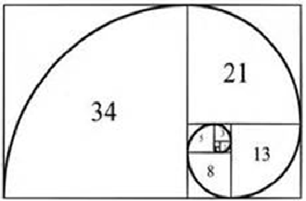
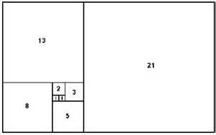
FIBONACCI SERIES
The sequence F_{n} of Fibonacci numbers is defined by the recurrence relation.
0, 1, 1, 2, 3, 5, 8, 13, 21, 34, 55, 89, 144, 233……………

Slide 8
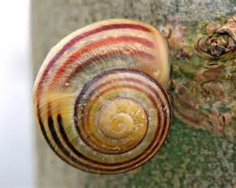
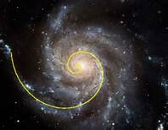
Sequence Fibonacci Spiral occurring in Nature.

Slide 9
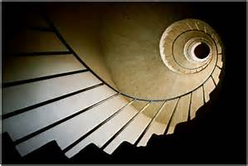
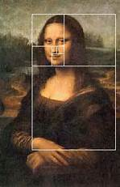
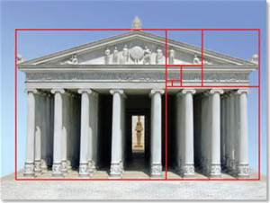
Fibonacci Sequence appllied in Art and Architecture.

Slide 10
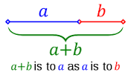
The Golden Ratio

Slide 11
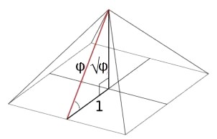
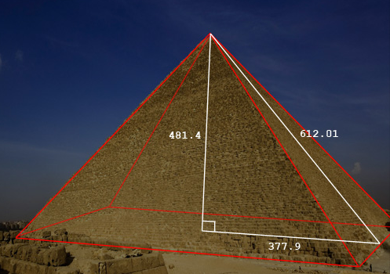
A
C
B

Slide 13
X

Slide 18
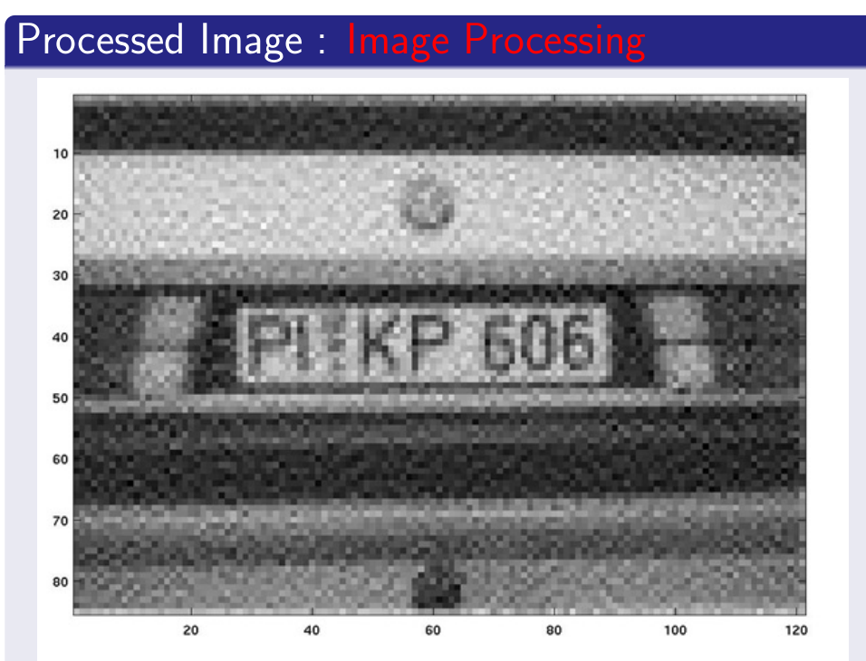

Slide 19
After a finite number of times repeating the above process, we get the original picture.

Slide 20
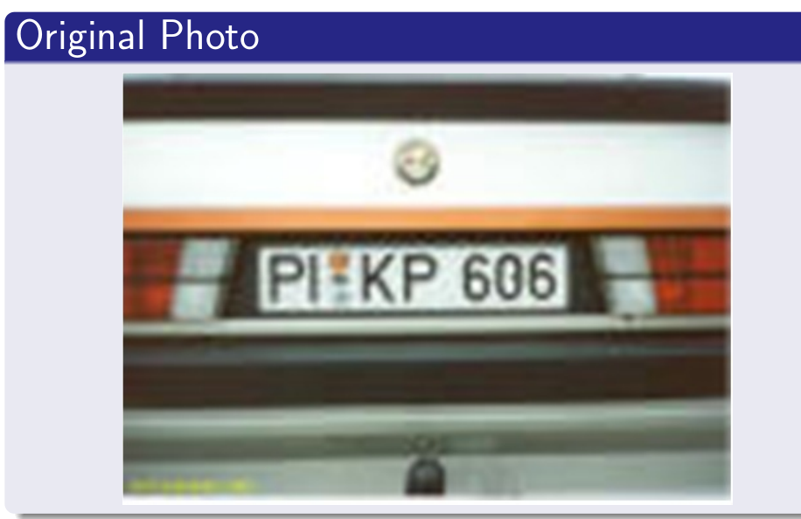

Slide 21
Applications
of
Mathematics
In
Music

Slide 22
Staff Notation
Measures and Time Signature:
Staff Notation.
Measure
Clef
Bar
Time signature
Notes
Rests
-Notes and Rests are:-
i) symbols that indicate Sound and Silence respectively.
ii) they act like constants with a specific time value.

Slide 23
MUSICAL RHYTHM
Rhythm is a sequence in time repeated.
And the rhythm is determined basically by
the Tempo and the Time Signature.
The Tempo is indicated in terms
of Beats Per Minute(BPM).
Eg.
=
80 BPM
The Time Signature actually gives the main structure of the rhythm.
Eg. , , ,……….

Slide 24
Equations concerning the regulation of the Rhythm:
Music written in a staff notation should satisfy the following equations concerning timing:
Where,
M= Measure
n= no. of Measures
N.B:- Unless further alteration of the Clef and the Time Signature exists
in the same notation.
And the Time Signature is always kept in the fractional form.

Slide 25
Distribution of the Time
Tempo:
Here we are not redefining
the value of
but giving it a specific Time Duration.
Thus,
=
80 BPM
secs.
0.75 secs.
0.75 secs.
0.75 secs.
0.75 secs.
The Time Duration
is w.r.t the
given Tempo.
Total Time Duration in 1 Measure= 3 secs
BPM: Beats Per Minute

Slide 26
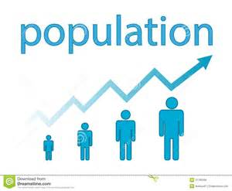
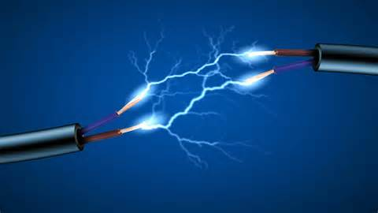
Mathematics
In
the Population Growth
and Electricity.

Slide 27
Differential Equation.
Exponential Growth - Population
Let ,
P(t) be a quantity that increases with time t
and the rate of increase is proportional to the same quantity P
The final form of the solution is given by, P(t) = P₀ e^{k t}

Slide 28
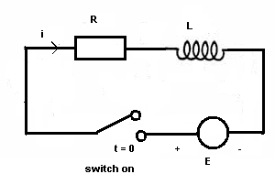
Differential Equation.
RL circuit
Let us consider,
the RL (resistor R and inductor L) circuit.
At t = 0 the switch is closed and
current passes through the circuit.
According to the laws the voltage across ,
A resistor of resistance
An inductor L is given by

Slide 29
Applications of Differential Equation.
Another law gives an equation relating all voltages in the above circuit as follows:
,where E is a constant voltage.
Solving the equation we get an expression
of the current in the circuit as a function of time.

Slide 30
LINEAR PROGRAMMING
X
12/-
Take a firm that produces two products X and Y
at a revenue of Rs. 12 and Rs. 15 per unit respectively.
Y
OBJECTIVE: To Maximize the Revenue.
15/-
OBJECTIVE FUNCTION: Max: f= 12x +15y
Note: The Objective Function states that if the two products X and Y bring revenue of Rs. 12 and Rs. 15 per unit, how much of these products be produced so that the firm earns the maximum revenue

Slide 31
Table
Amount of Inputs Required to Produce One Unit of Output |  |  | Total Inputs Available In each case Unit
INPUT | X-units | Y-units | Units
A | 12 | 04 | 48
B | 06 | 12 | 72
C | 14 | 12 | 84
Net Revenue Per Unit of Product | Rs. 12 | Rs.15
The Table can be written in the following equations:
12x + 4y ≤ 48………………(i)
6x + 12y ≤ 72……………...(ii)
14x + 12y ≤ 84……………...(iii)

Slide 32
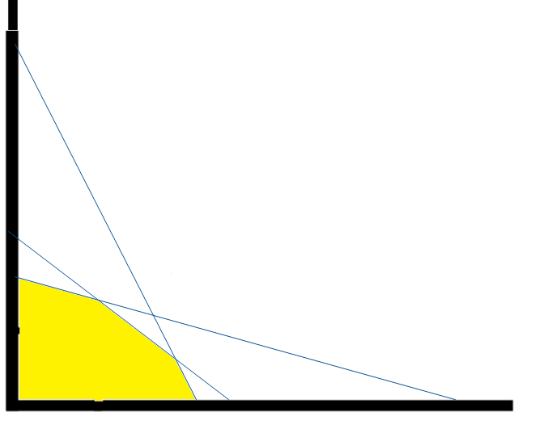
Graph of the equations:
A
Here,
12x + 4y ≤ 48………………AB
6x + 12y ≤ 72………………CD
14x + 12y ≤ 84………………EF
Co-ordinates of the edge of the shaded portion:
C (0 , 6) , S (1.5 , 5.25) ,
T (2.73 , 3.81), B( 4 , 0)
E
C
S
T
B
F
D

Slide 33
Substituting the respective co-ordinates in the OBJECTIVE FUNCTION,
Given by,
f=12x +15y
At B, = 48
At T, = 89.91
At S, = 96.75
At C, = 90
Here, > > >
This shows that given the prices of the two products X and Y and given the amount of inputs, the total revenue of the firm is maximized at point S.

Slide 34
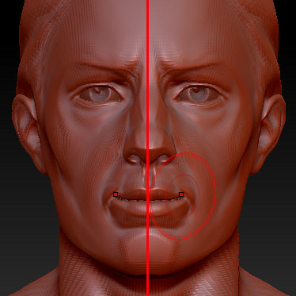
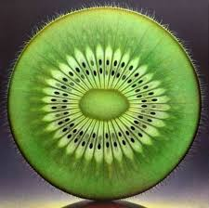
Group Theory
Groups of symmetries are used to reduce the dimension of parameter spaces in engineering models to make model verification more tractable.

Slide 35
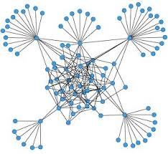
Partial differential equations
Partial differential equations are used a lot for modeling systems in biology and medicine,
and help describe e.g. animal coat pattern formation (zebras, leopards...), wound healing, tumor growth, spread of a virus in a population, predator-prey systems in ecology, predicting the variations of concentrations of chemicals (hormones, drugs...) within an organ over time...

Slide 36
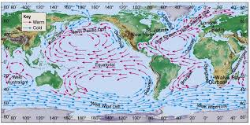
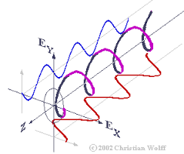
Partial differential equations
PDEs are used in climate modeling, from atmospheric dynamics to ocean currents.
Radar imaging is based on solving an inverse problem. The recent buzz about meta-materials and invisibility is based on understanding variable-coefficient elliptic problems.

Slide 37
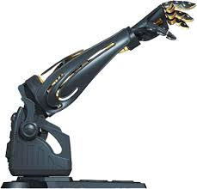
Algebraic Geometry
Configuration spaces of robot arms are semi-algebraic sets, and algebraic geometry (especially the Cylindrical Algebraic Decomposition) has been used to understand their geometry and design algorithms.

Slide 38
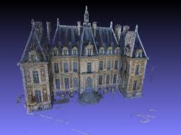
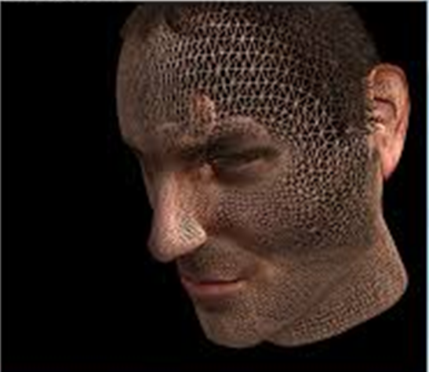
Algebraic Geometry
Projective geometry and implicitization is used in 3D image reconstruction from multiple camera views.

Slide 39
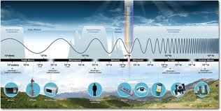
Classical Analysis
Fourier analysis allows one to precisely divide up the electromagnetic spectrum, leading of course to radio, television, wireless, and so forth.
The fast Fourier transform (and relatives, such as the fast Wavelet transform) is an essential component of many signal processing algorithms.

Slide 40
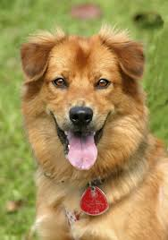
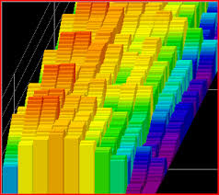
Rings and Algebras
Fourier analysis / transforms and linear algebra is at work in the world millions of times per second (video, audio).
In particular, it requires the discrete fourier transform in creating or displaying a JPEG image.

Slide 41
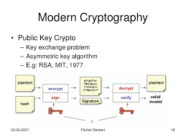
Number Theory
From Number Theory comes the ideas and theoretical basis for modern cryptography, used to secure communications everywhere from banking to cellphones.

Slide 42
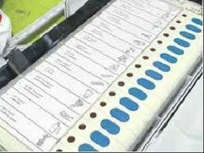
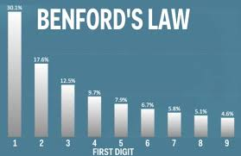
STATISTICS
- Accurate polling
- Fraud detection: whether financial
(e.g. via Benford's law) or voter fraud.
-Used in the world of finance, economics and gambling on a daily basis.
-Predicting consumer preferences (e.g. Netflix prize)

Slide 43
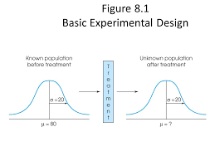
STATISTICS
-Experimental design and hypothesis testing (e.g. testing of medical hypotheses)
-Machine learning
-Quality control

Slide 44
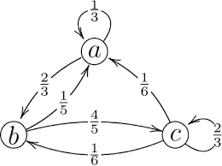
Probability
Markov chains are used to find uniformly random objects.
This, among other things, makes designing an experiment fairest
and crypto-systems based on designs securest.

Slide 45
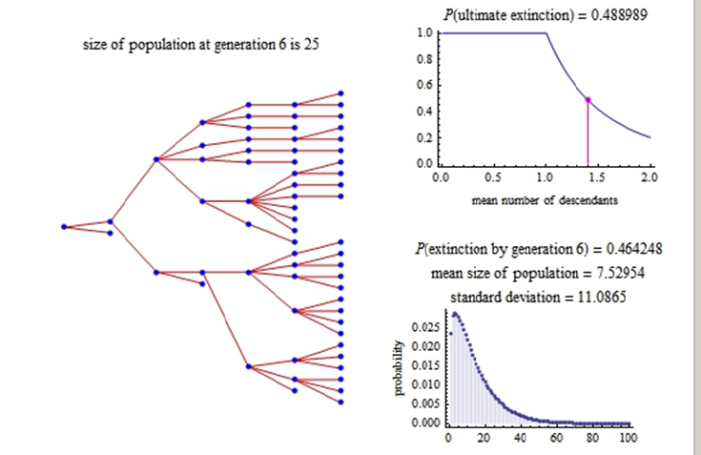
Probability
Stochastic processes such as branching processes and HMMs are used to model speciation and extinction (the Tree of Life), evolution of molecular sequences, cell proliferation, and other things in biology.

Slide 46
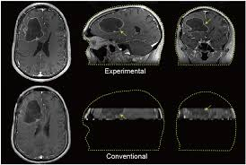
Numerical analysis
Linear programming algorithms are used in , compressed sensing
which is now being used in MRI and imaging to increase resolution and/or decrease the number of measurements required.

Slide 47
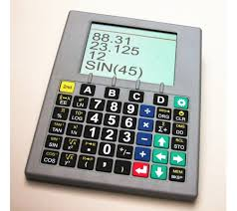
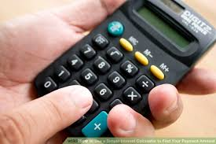
Numerical analysis
Numerical analysis is what makes calculators work.

Slide 48
Functional Analysis
- Used in signal processing for modeling and design.
-Used in machine learning in the design of classifiers. (e.g. spam filters)

Slide 49
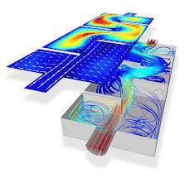
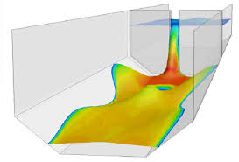
Dynamical systems
Modeling flow of liquids, like the animated flow of lava in the movie "Volcano“.

Slide 50
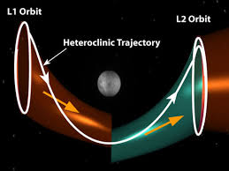
Dynamical systems
Heteroclinic trajectories are used in space mission design.
Heteroclinic tangles are used by chemical engineers to get well-mixed reactants

Slide 51
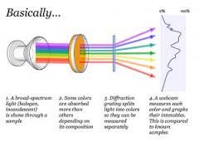
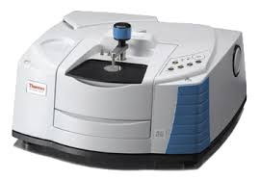
Spectral theory
Spectroscopy
To avoid bridge collapse, knowing where the resonant frequencies are.

Slide 52
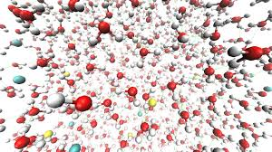
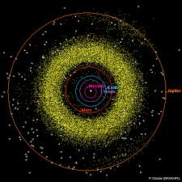
Symplectic Geometry
Symplectic integrators are used for numerical simulation of Hamiltonian mechanics.
Prominent applications include molecular dynamics, solar system dynamics, computer animation, and a wide variety of problems in mechanical engineering.

Slide 53
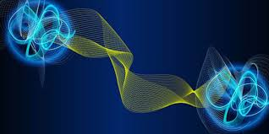
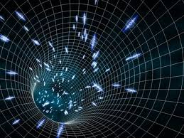
Operator Algebras
Operator algebras, and, more broadly, operator theory, appear in mathematical models for quantum phenomena.

Slide 54
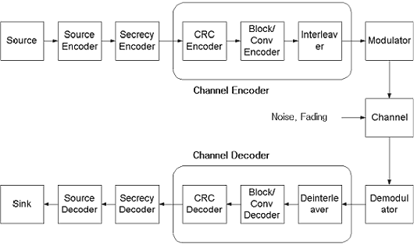
Metric Geometry
Discrete sphere packing solutions lead to error-correcting codes

Slide 55
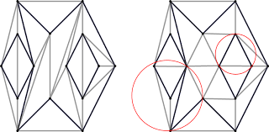
Metric Geometry
Triangulation using the Euclidean metric is used for navigation (and nowadays, in GPS systems)

Slide 56
Optimization and Control
Optimization is heavily used in medicine for cancer treatment, in a technique of radiation therapy called Intensity Modulated Radiotherapy (IMRT)

Slide 57
General Mathematics
The cosmic distance ladder is largely built using elementary geometry

Slide 60
THANK YOU!!!

